Slide 1
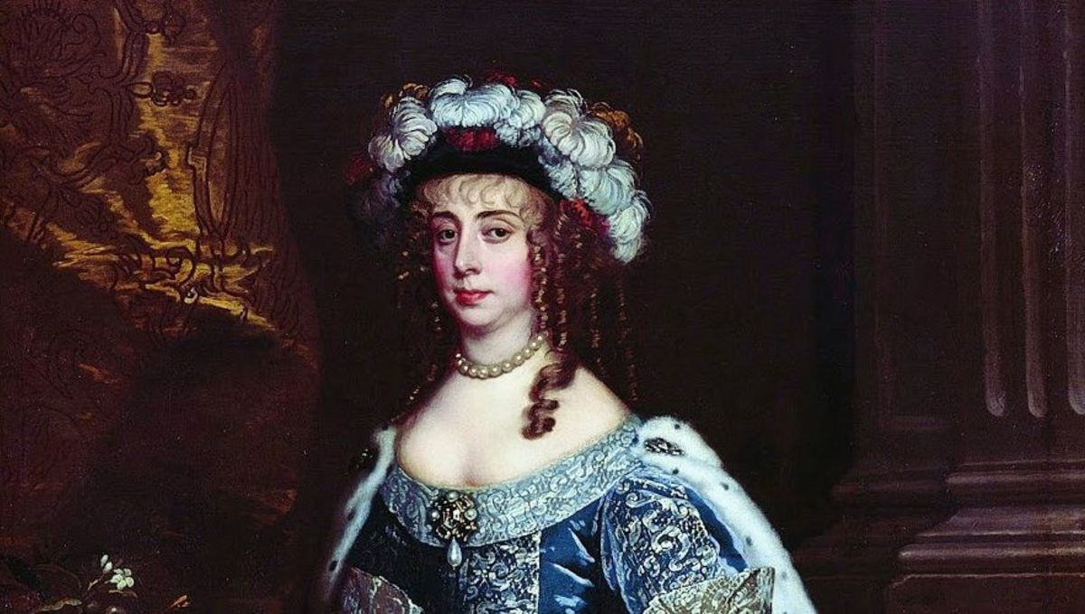
Women philosophers of the seventeenth century
GENT 9/409: Foundations of the Modern World (1600-1690)
Stephanie Spoto
Monterey Peninsula College

Slide 2
Lady Masham Damaris (1659-1708)
English writer, theologian, philosopher, women’s education advocate
Sometimes characterized as a proto-feminist
Had poor eyesight and a lack of formal higher education → overcame these obstacles
Received high regard among eminent intellectuals of the seventeenth century
Published two works:
A Discourse Concerning the Love of God (1696)
Thoughts in Reference to a Vertuous or Christian Life (1704)
Had a lifelong friendship with the philosopher John Locke → influenced each other’s philosophy

Slide 3
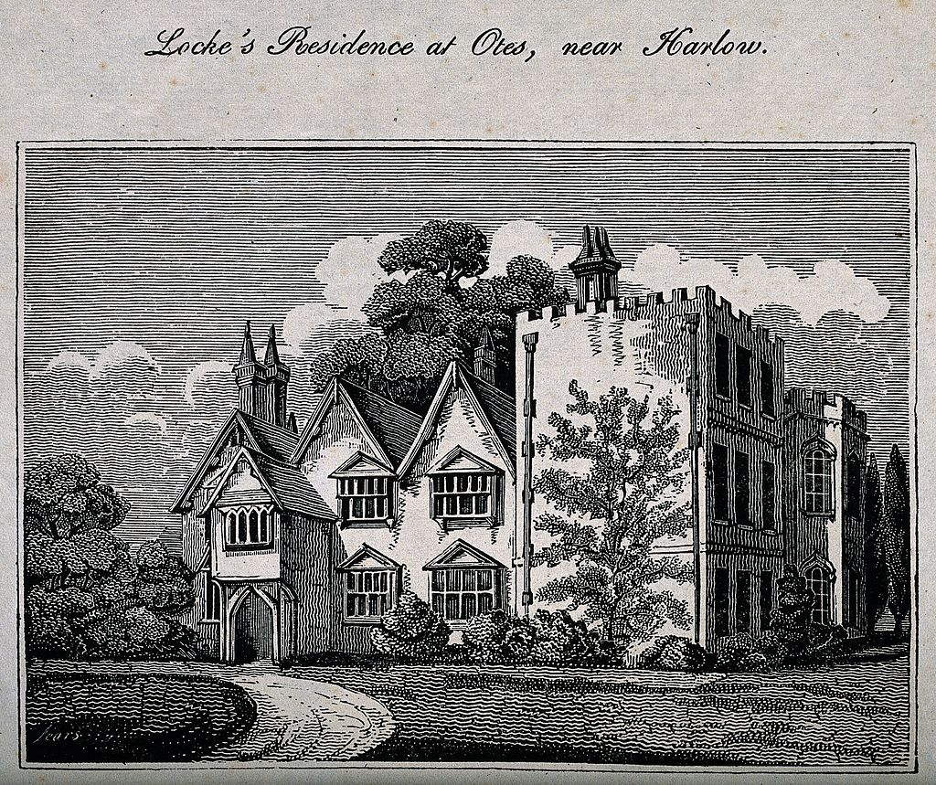
Influence and intellectual circle of Damaris
From the time of her early twenties until her death, she had close correspondence and friendships with a number of intellectuals and philosophers
Close friendship with John Locke that would last until his death in 1704 → she attended his deathbed
Met at some point before 1682 and exchanged many letter → often very flirtatious and personal letters
Locke on Damaris in letter to Phillipp van Limborch: : “The lady herself is so well versed in theological and philosophical studies, and of such an original mind that you will not find many men to whom she is not superior in wealth of knowledge and ability to profit by it.”
Locke moved in with her in 1691 and stayed there until his death in 1704
Brought a library of 2,000 books, bought a writing desk for Damaris, paid for the binding of her works, paid for her ink and quills
Locke’s last will and testament is full of gifts and arrangements for Damaris and her son Francis.

Slide 4
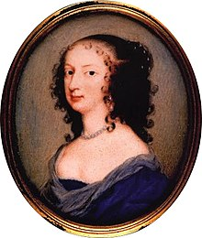
Margaret Cavendish & Anne Conway
Margaret Cavendish remembered primarily for her innovative work The Blazing World (1666) → pioneer text of science fiction
Wrote on political and scientific subjects → championing a progressive natural philosophy and materialism
Published the same year as The Blazing World, her Observations upon Experimental Philosophy demonstrates engagement in progress in scientific innovations
Margaret Cavendish and Anne Conway are often compared: only six years separating their deaths, brought up in similar circumstances
Alice Theobald says: “make for an apt pair in considering not just some of the varying views in natural philosophy circulating in Restoration England but also their remarkable contribution of female voices to an otherwise male-dominated public and intellectual arena.”
Margaret Cavendish

Slide 5
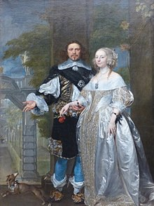
Margaret Lucas Cavendish, Duchess of Newcastle-upon-Tyne (1623 –1673)
English aristocrat, poet, philosopher, scifi writer, scientist, and playwright
Youngest sister of Sir John Lucas and Sir Charles Lucas, both prominent royalists
She became attendant to Queen Henrietta Maria, traveled with her to France in exile, lived in the court of Louis XIV
Married William Cavendish, first Duke of Newcastle-upon-Tyne in 1645
Published under her own name → at the time, most women published anonymously
Writing addressed many topics including power, scientific method, gender, and philosophy → published extensively in philosophy and early modern science
Published over a dozen original works, but if we include all her revisions, the number goes up to 21

Slide 6
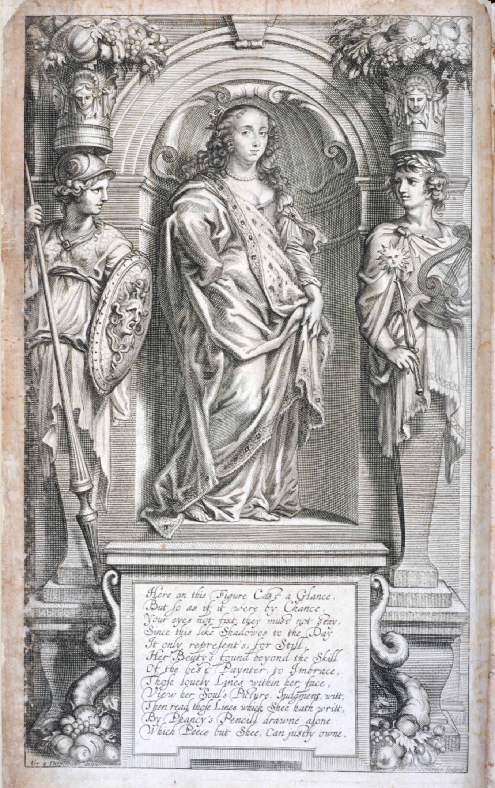
Margaret Cavendish Natural Philosopher
Cavendish was praised and criticized as a groundbreaking woman author and thinker
Rejected Aristotelianism and mechanical philosophy popular among her contemporaries
Preferring a vitalist model: “living organisms are fundamentally different from non-living entities because they contain some non-physical element or are governed by different principles than are inanimate things. In its simplest form, vitalism holds that living entities contain some fluid, or a distinctive 'spirit’.”
First woman to attend a meeting of the Royal Society of London in 1667
Engaged in intellectual debate with, and sometimes criticized, the philosophy of philosophers Thomas Hobbes, René Descartes, and Robert Boyle.
She was critical of animal testing and engaged in animal advocacy

Slide 7
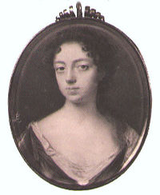
Viscountess Anne Conway (1631-1679)
English philosopher → engaged in the tradition of the Cambridge Platonists
Cambridge Platonists: Group of English philosophers at Cambridge in the seventeenth century, including Henry More.
Upheld the philosophy of Plato and Plotinus, but were also interested in modern philosophical advancements.
Critical of scholasticism as a dominant form of institutional philosophy and instead were interested in advancements in science
First philosophers to write primarily and consistently in English
Her work was influential on Gottfried Leibniz, important philosopher in logic and mathematics
Her philosophy is an original form of rationalism, with women-centered concerns and patterns that make it unique among its contemporaries
Rationalism: theory that beliefs should be based off of reason rather than religious conviction

Slide 8
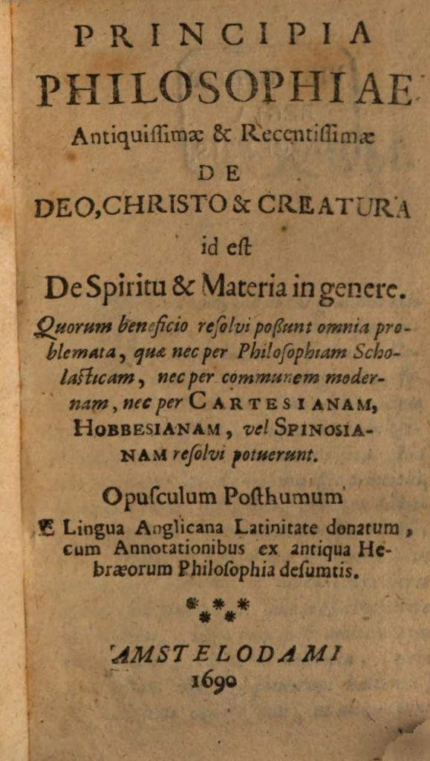
Anne Conway: Influence and Philosophical Engagement
Common among contemporary women thinkers, Conway never wrote for credited publication
Engaged in longstanding written correspondence with Henry More, one of the time period’s most important thinkers.
He introduced her to many of the members of the Cambridge Platonists
Her 1690 posthumous publication Principles of the Most Ancient and Modern Philosophy shows the influence of the Cambridge Platonists on her ideas of matter and spirit
These ideas would go on to influence Leibniz’s idea of the monad: the idea of an elementary particle

Slide 9
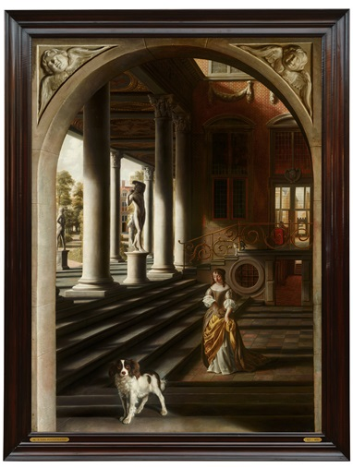
Anne Conway: God and the Natural World
Though Conway is often framed as a mere container to promote the ideas of her male contemporaries, many see her posthumous philosophical work as an active response to the intellectual thought of her day.
Presents her own unique assessment of Platonism, informed by Kabbalism
Conway is pious → asserts that ‘Creatures have their Being and Existence simply and alone’ from God.
Founded her inquiries in natural philosophy on a religious foundation → blends theology into her study of the natural world
Conway: ‘the Justice of God marvellously appears’ in the works of nature, rightly bestowing upon infidels their ‘due and proper Punishment’.
Samuel van Hoogstraten (1627 - 1678)
Perspective View with a Woman Reading a Letter

Slide 10
Margaret Cavendish’s materialism vs. Conway’s immaterialism
In contrast to Conway’s natural theology, Cavendish has a more celebratory approach to the human and material existence.
Cavendish: The mind itself is material → departure from Descartes, who believed that the mind was a “thinking thing” (res cogitans) and made of an immaterial substance (c.f. Hobbes’s critique of “immaterial substances”) → Descartes: subordinated the physical material body to the immaterial mind
Cavendish promoted materialism and centered her philosophy around the body as a physical and knowable substance → the body was “the cause”, a source of motion and dynamism (c.f. Hobbes’s idea of the human as motion)
Cavendish focuses on natural minutiae → whereas Conway concerned with praising God as ‘in a proper and real sence, a Substance or Essence distinct from his Creatures’
a distinction that does not, however, hinder Conway being able to find in nature ample cause for celebrating him.

Slide 11
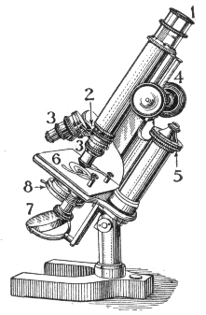
The Epistemology of Cavendish: What we can know?
Though a natural, materialist philosopher, Cavendish recognizes God as a great “Being” → but “Unexpressible, and Incomprehensible” → God is not accessible to us in His “infinite nature”
Though this philosophy is skeptical (philosophical idea that certain knowledge is impossible), she still gives a “one ground or principle” which we can be certain of: “which is self-motion, or self-moving matter” observable in nature.
Her Observations claim that there is “more than man is able to know” → but she is interested in the material, natural, and immediate world → interested in experimental knowledge that can be gained from the material world
Interested in new technologies like the microscope, a tool which she often praises

Slide 12
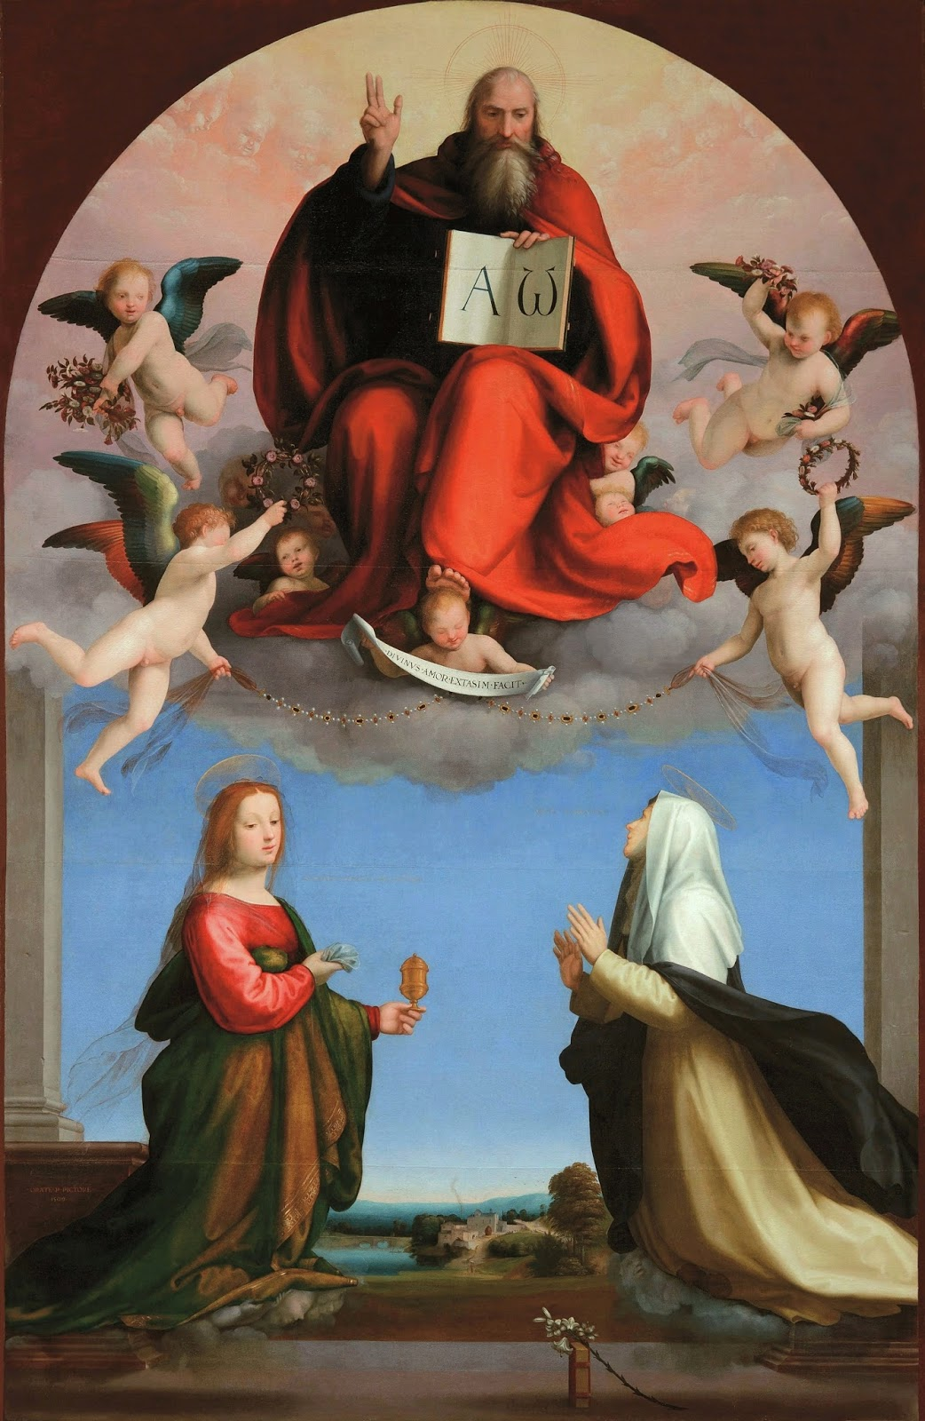
Conway & Cavendish on God
Cavendish doesn’t ignore God: “God [who] hath implanted a faculty of knowing in every creature”
Writes a panegyric on ‘the variety of nature in all her works’ as a physical being
Conway more open and jubilant in her praise of God, opening her treatise with ‘God is a Spirit, Light, and Life, infinitely Wise, Good, Just, Mighty, Omniscient, Omnipresent, Omnipotent, Creator and Maker of all things visible and invisible’.
Rejoices that God is “universally one in himself, and of himself, without any manner or Variety or Mixture”

Slide 13
Conway and Cavendish on writing
Use similar analogies to describe the process of their thinking and writing
Both consider their writing and thought expansive, guided by rational systems
Conway and Cavendish use similar architectural metaphor when describing the transcription of abstract idea to concrete thought:
Conway: “the Will join’d with the Idea, as when a Master-Builder conceives in his Mind the Idea of an House […] co-operates”.
Cavendish justifies her literary pursuits and departure from typical feminine duties, terming her writing a form of ‘Spinning with the braine’.
Differences in literary motivations:
Cavendish a personal goal: : ‘[I] endeavour to Spin a Garment of Memory, to lapp up my Name, that it might grow to after Ages’ → wants her book to gain ‘Respect, and Esteeme in the World’
Conway asserts an impersonal goal, while her publisher wanted her to have the fame sought by Cavendish, it has no origin in Conway’s own philosophy

